Slide 1
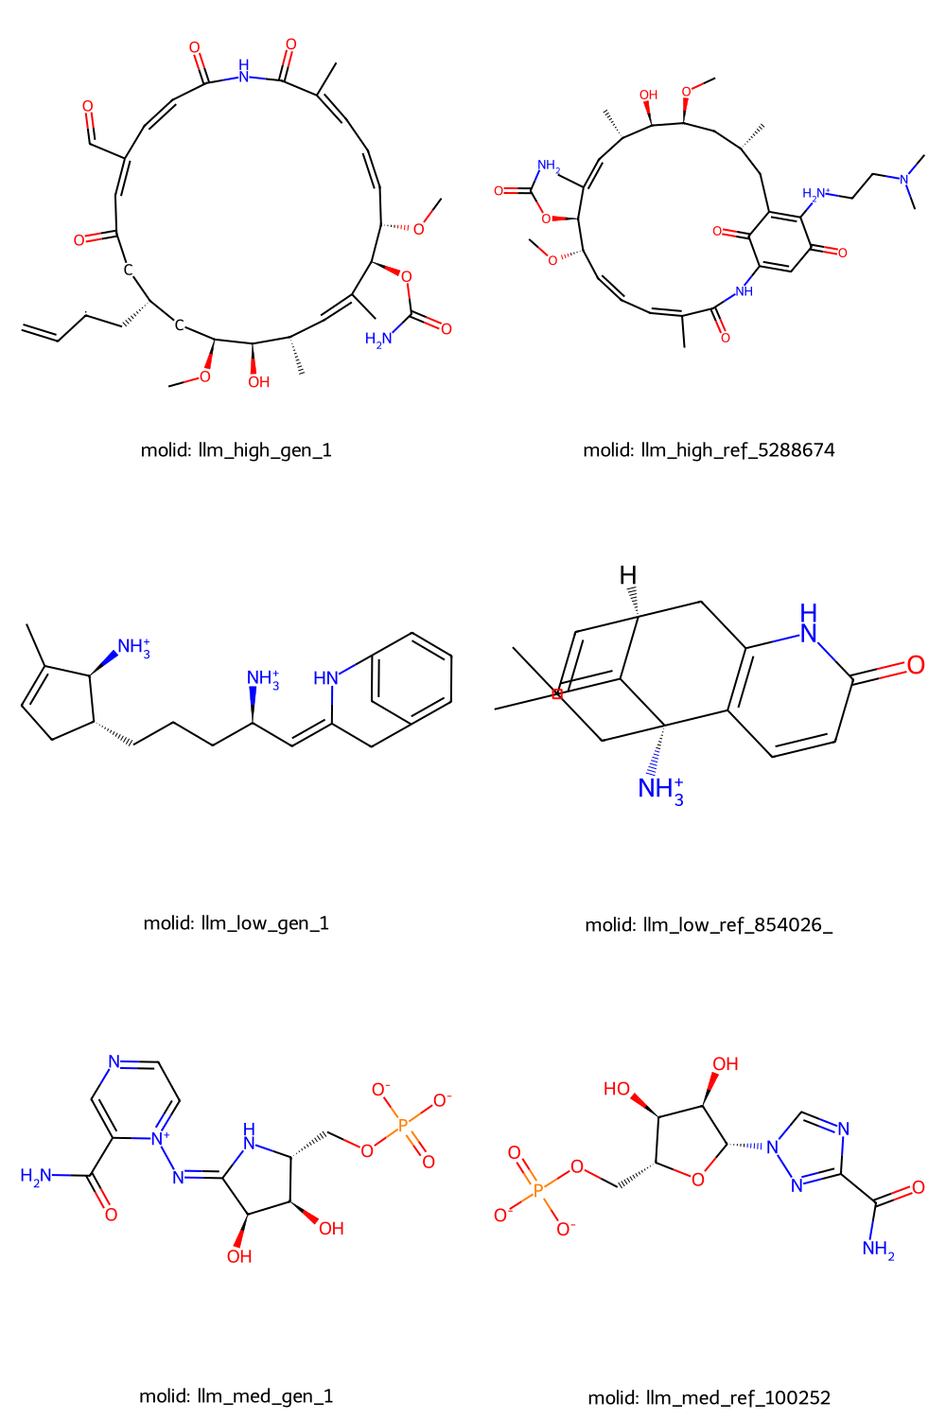
ChemLML
T5+MolGen
Top predictions
“High” similarity
Hsp90alpha
“Medium” similarity
Inosine-5’-monophosphate
dehydrogenase
“Low” similarity
Acetylcholinesterase

Slide 2
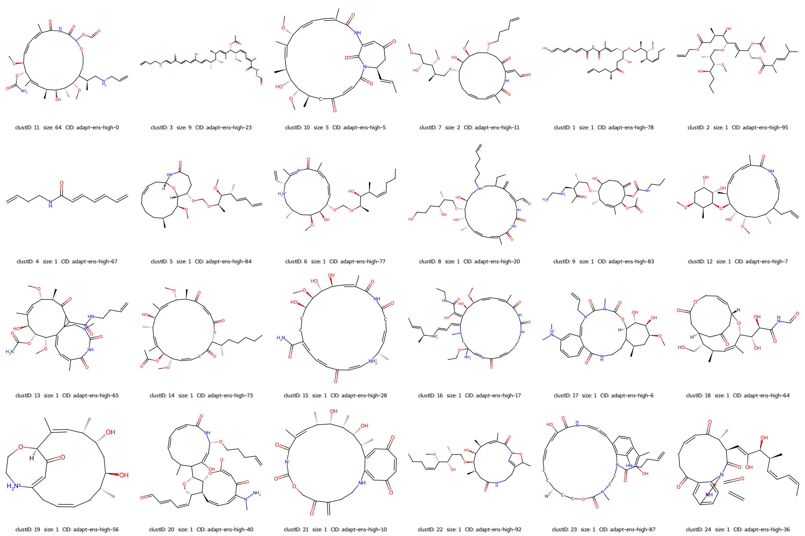
ChemLML
T5+MolGen
“High” similarity
Hsp90alpha

Slide 3
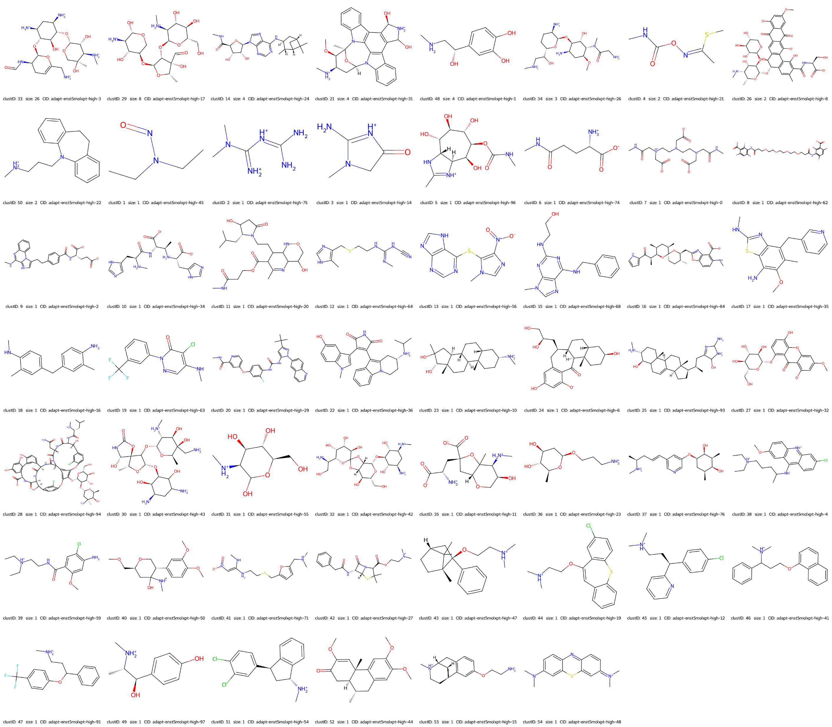
ChemLML
T5+MolXPT
“High” similarity
Hsp90alpha

Slide 4
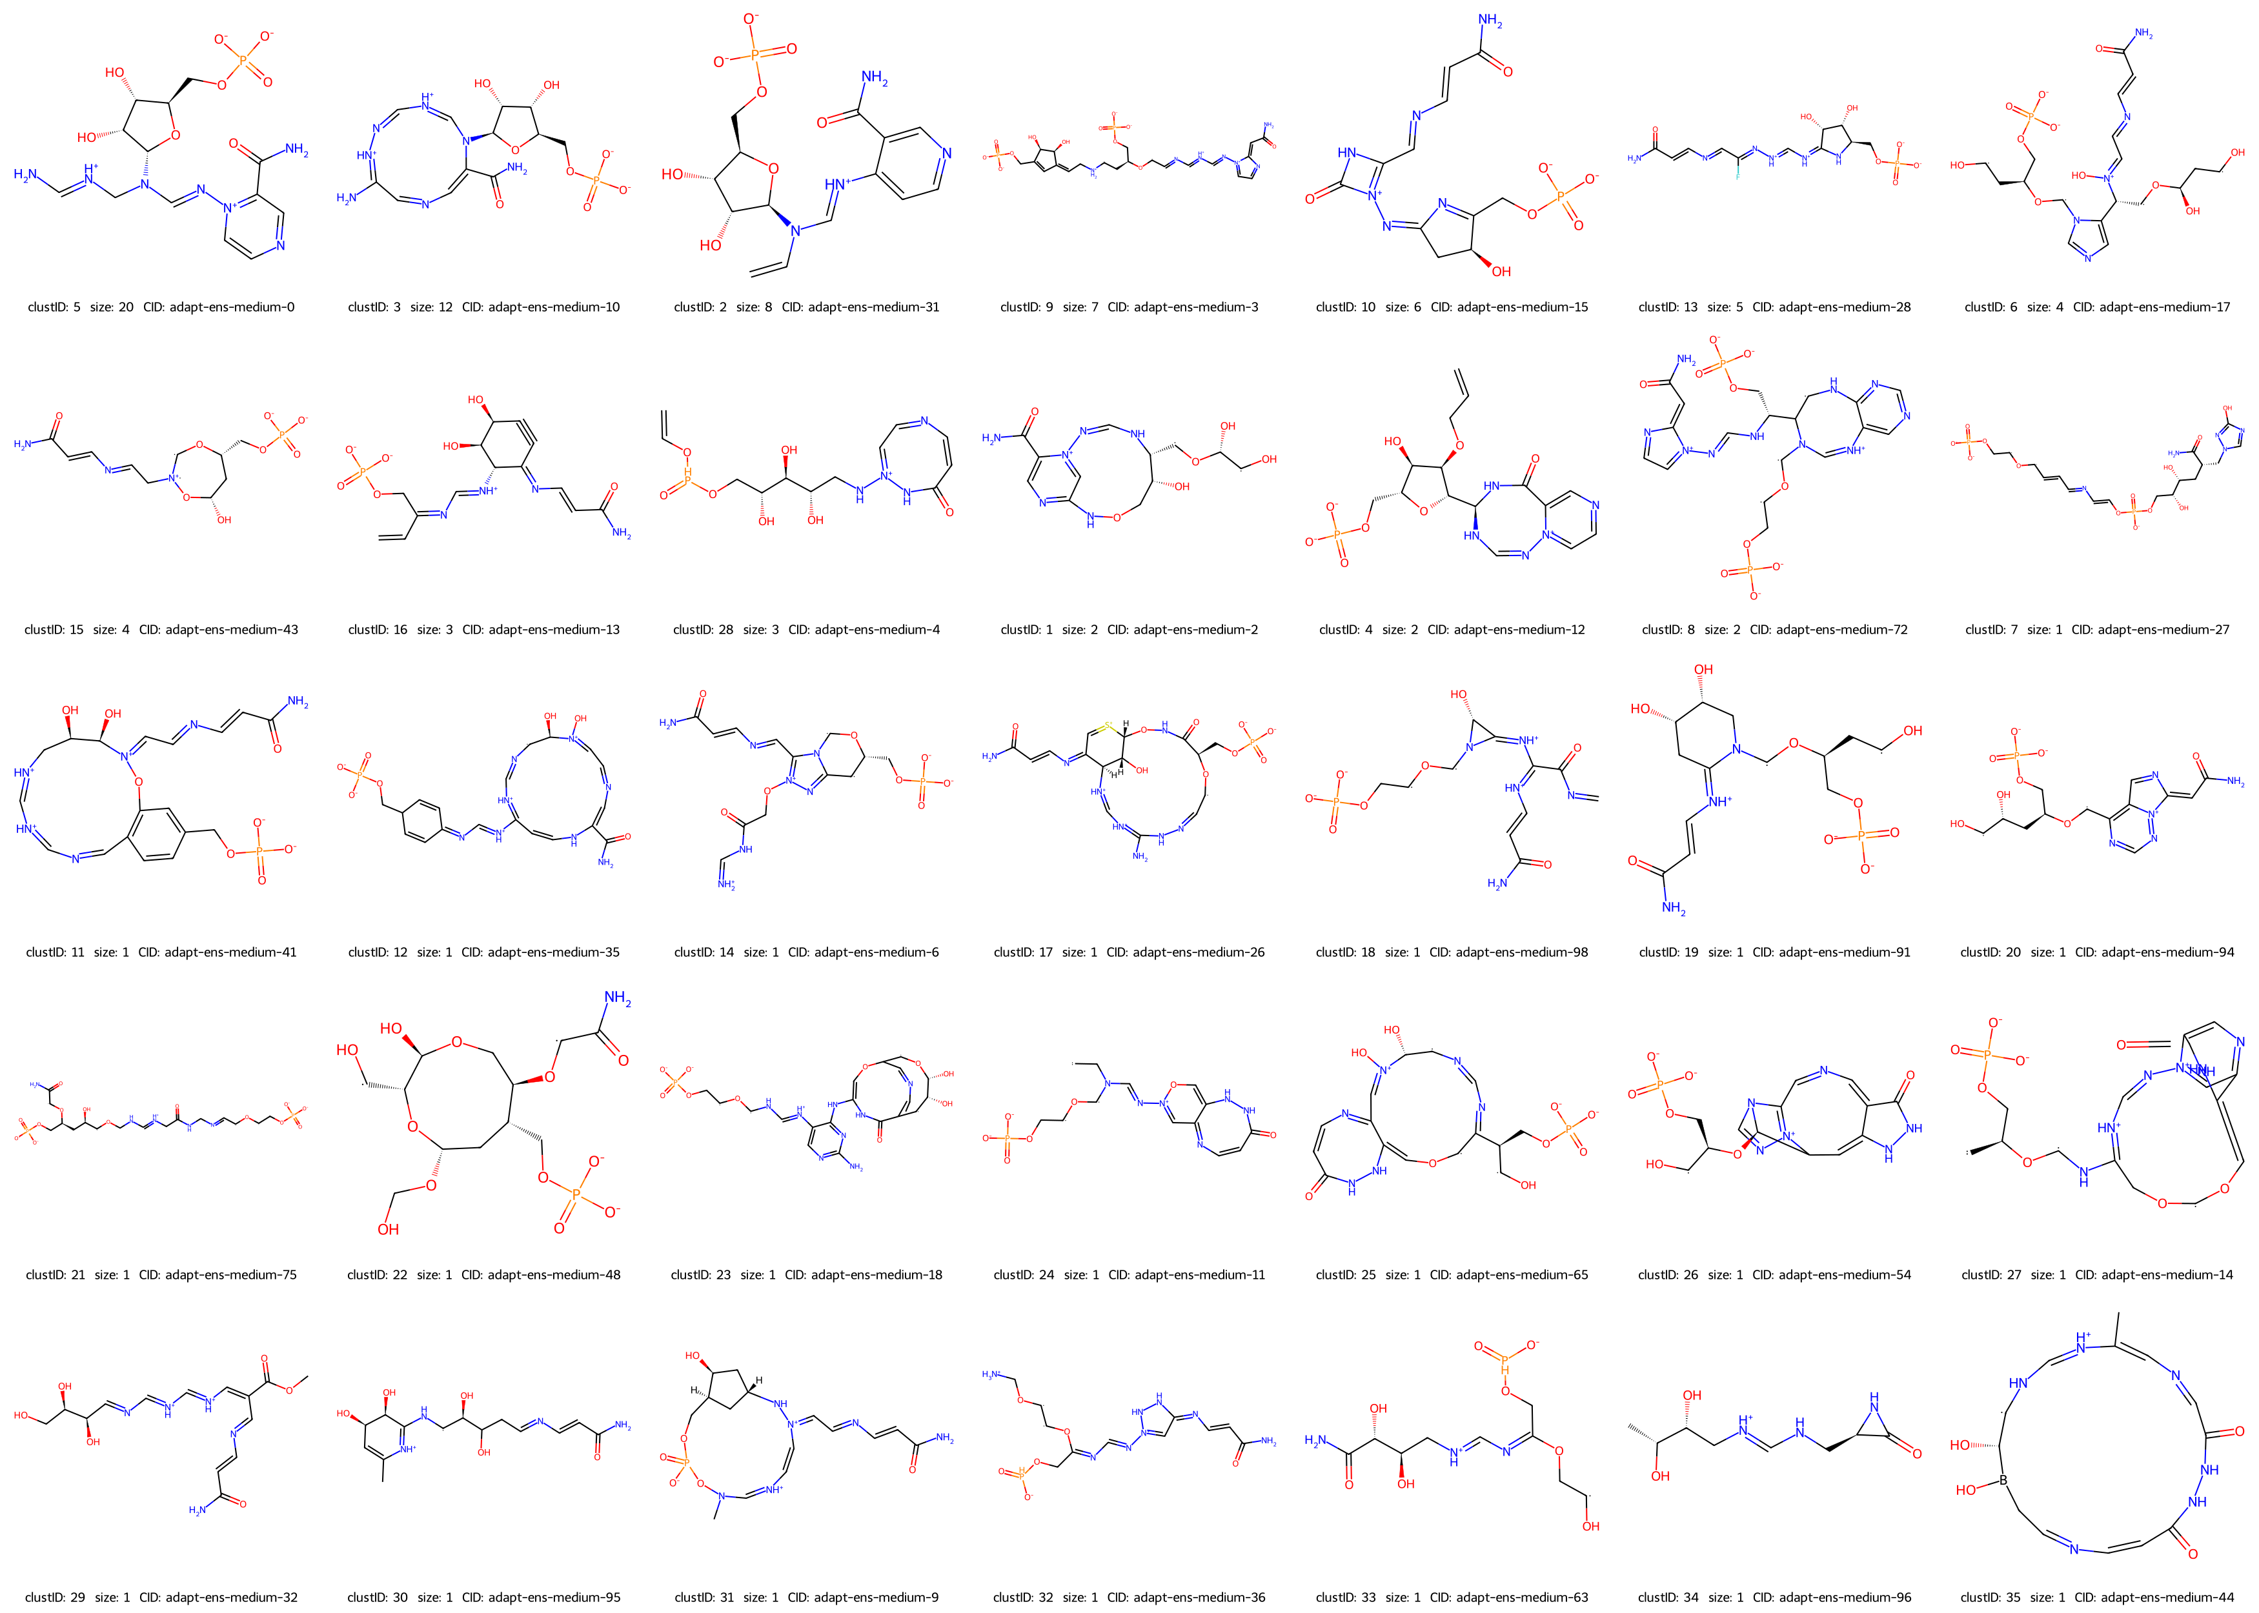
ChemLML
T5+MolGen
“Medium” similarity
Inosine-5’-monophosphate dehydrogenase

Slide 5
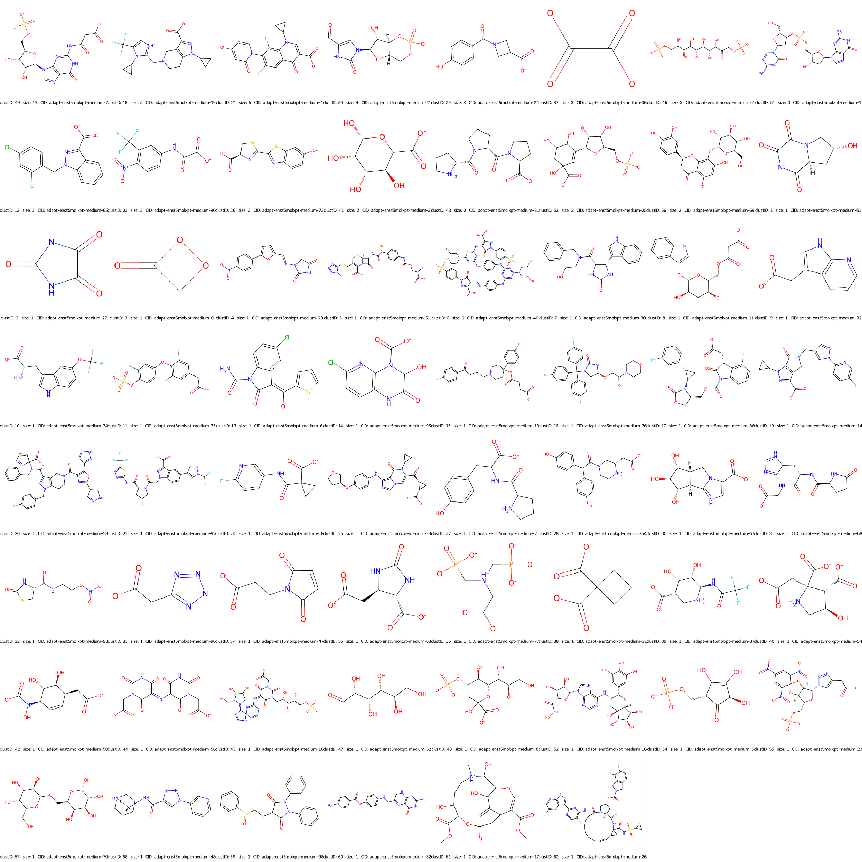
ChemLML
T5+MolXPT
“Medium” similarity
Inosine-5’-monophosphate dehydrogenase

Slide 6
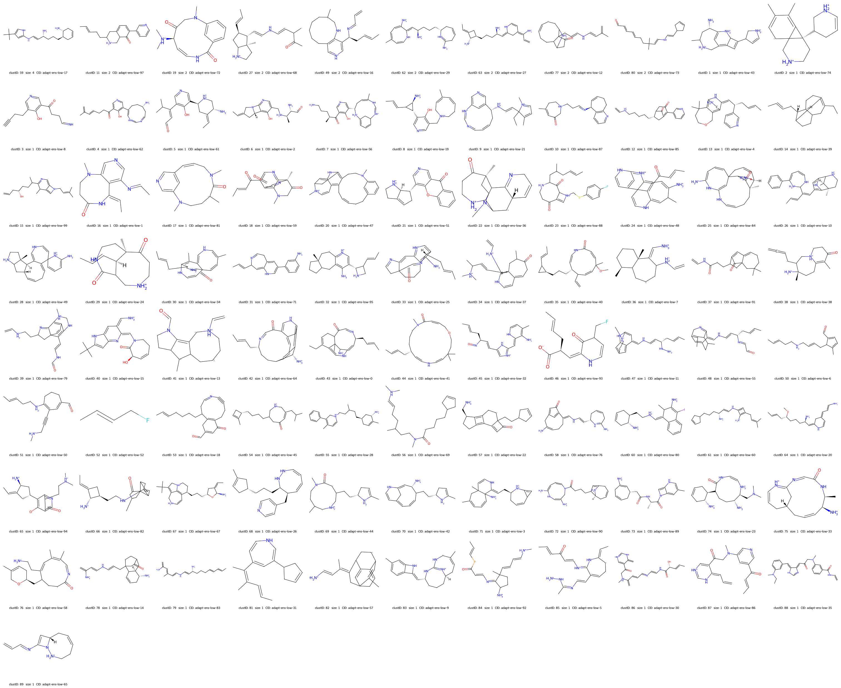
ChemLML
T5+MolGen
“Low” similarity
Acetylcholinesterase

Slide 7
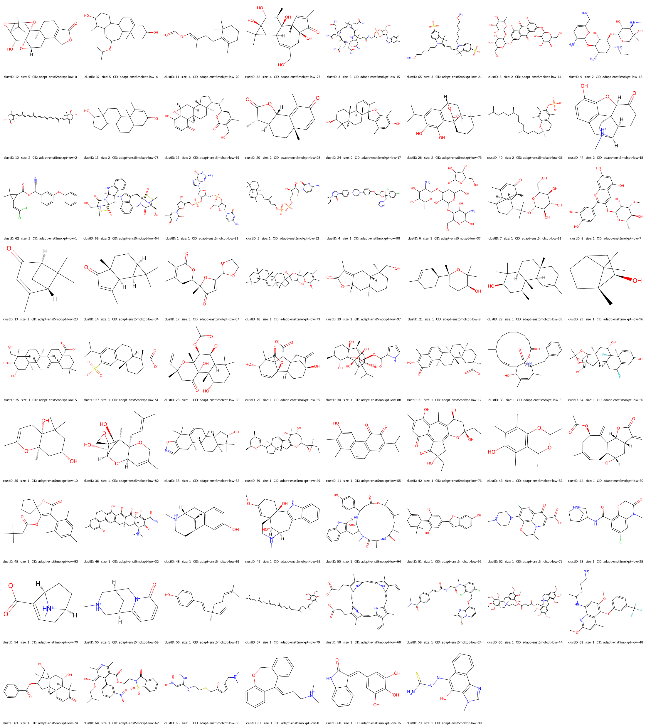
ChemLML
T5+MolXPT
“Low” similarity
Acetylcholinesterase

